Slide 1
Microbiome Disruption & Microbiome-Based Therapeutics:
Open Questions & Logistical Challenges
Brendan J. Kelly, MD, MS
Jennie H. Kwon, DO, MSCI
Michael Woodworth, MD, MSc

Slide 2
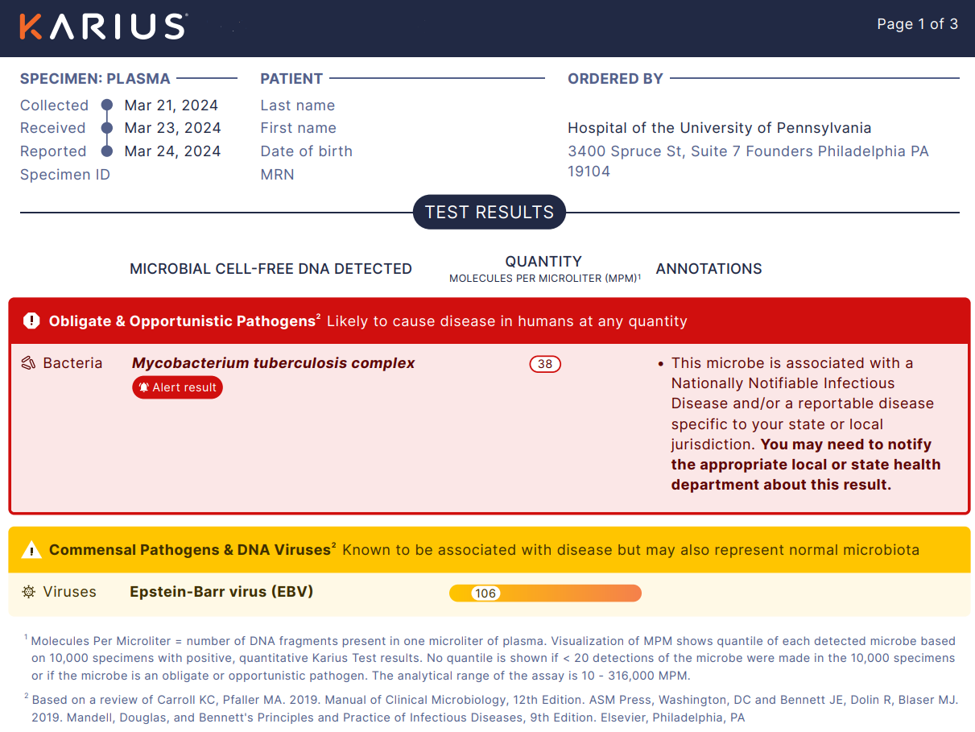
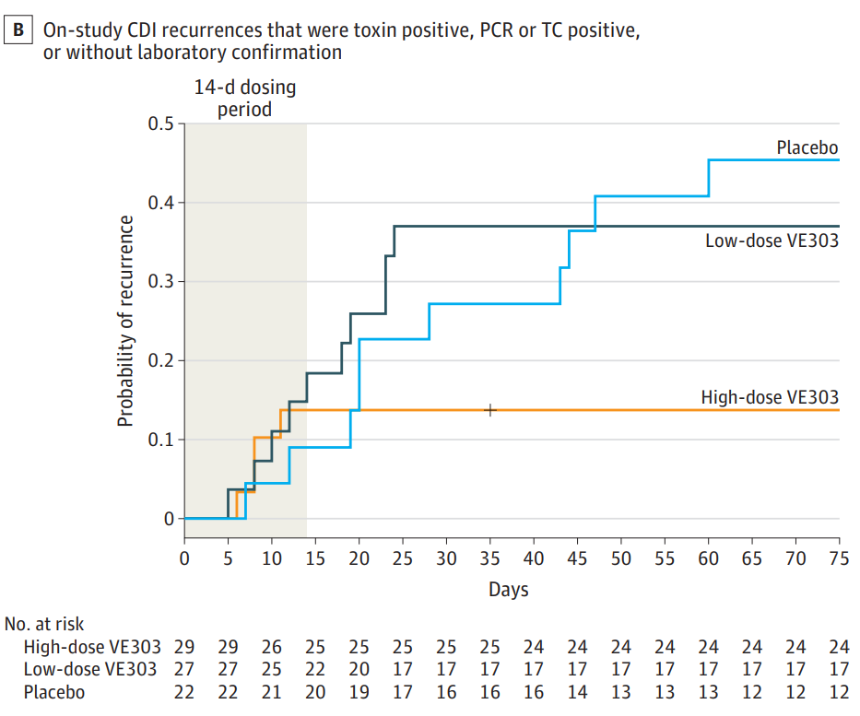
A New Era of Infectious Disease Medicine
Sequence-based diagnostics
sterile body sites: plasma cfDNA (e.g., Karius), joint fluid, CSF
Live biotherapeutic products
2 first-generation LBPs approved; second-generation in phase 3
Blauwkamp TA Nature Micro 2023; Ivy MI J Clin Micro 2018; Wilson MR NEJM 2019; Khanna S Drugs 2022; Feuerstadt P NEJM 2022; Louie T JAMA 2023

Slide 3
Microbiome Disruption Indices (MDIs)
SBDs & LBPs demonstrate utility of high-throughput sequencing to detect microbial pathogens & effect size of ecological interventions
Challenge & opportunity: bacterial and fungal pathogens, including MDROs, colonize respiratory and gastrointestinal mucosal surfaces
pathogen detection sensitivity/specificity
interspecies interactions matter: information on whole community
connections to quantifiable colonization resistance & antibiotic effects
multiple MDIs, rather than one-size-fits-all
Halpin AL Am J Inf Con 2016; Pettigrew MM Clin Inf Dis 2018

Slide 4
MDI Intent: Diagnosis vs Prediction
SBDs & LBPs

Slide 5
MDI Intent: Colonization Resistance
SBDs & LBPs

Slide 6
Approach: Relative vs Absolute Abundance
SBDs & LBPs

Slide 7
MDI Approach: Enrich vs Agnostic
SBDs & LBPs

Slide 8
MDI Approach: Metagenomic Pipeline
SBDs & LBPs

